Slide 1


Slide 2


University Fleet Optimization System
Pre-Final Year Project Synopsis
Submitted by
ROLL | NAME
2401830002 | Naman Katewa
2401840003 | Sneha Yadav
2401840006 | Akshaya Tanwar
2401840008 | Nikita Saharan
2401720014 | Kartikeya Drall
Faculty Mentor: Ms. Rishika Mehta
Notes:
New Courses replaced with New Programmes

Slide 3

Project Overview
The Problem:
Managing university transportation across a massive catchment area(Sohna, Gurugram, Faridabad, Palwal, Noida, Bhiwadi) is manually intensive.
Current fixed routes lead to inefficiencies, high fuel costs, and uneven student loads.
The Solution:
A "Zero-Operational Cost" fleet management system built entirely on open-source technologies.
Replaces expensive commercial APIs (Google Maps) with self-hosted routing engines.
The Goal:
To automate route planning using mathematical optimization (VRP) to minimize fleet travel distance and ensure equitable service for distant locations.
Notes:
New Courses replaced with New Programmes

Slide 4
Specific Objectives
Zero-Cost Architecture:
To achieve professional routing capabilities using self-hosted OSRM and OpenStreetMap data, eliminating recurring API fees.
Regional Optimization:
To effectively model the specific road networks of Haryana and Uttar Pradesh (Extended NCR) for accurate travel time predictions.
Algorithmic Efficiency:
To implement the Vehicle Routing Problem (VRP) using Google OR-Tools to mathematically minimize total fleet mileage.
Constraint Enforcement:
To strictly enforce service rules: Maximum 2-hour ride time and Bus Capacity limits (e.g., 50 seats).
Notes:
New Courses replaced with New Programmes

Slide 5
Key Features
No Recurring Costs:
Runs entirely on local university infrastructure or free-tier cloud services.
Custom Speed Profiles:
Routing engine calibrated for "Bus" speeds in NCR traffic, not generic car speeds.
Strategic Comparison Mode:
Allows admins to toggle between "Strict" plans (visit every stop) and "Suggested" plans (merge stops for efficiency).
Interactive Dashboard:
A Next.js-based admin panel to visualize routes, manage student demand, and export driver schedules.
Notes:
New Courses replaced with New Programmes

Slide 6
Progress Summary (~60% Complete)
Phase | Status
Phase 1: Infrastructure & Core Setup | Complete
Phase 2: Data Management | Complete
Phase 3: Routing & Distance Matrix | Complete
Phase 4: Optimization Engine | Almost Complete, few bugs
Phase 5: Visualization & Dashboard | In Progress
Phase 6-9 Comparison, Export, Deployment | Upcoming
Notes:
New Courses replaced with New Programmes

Slide 7
Detailed Progress – Development Phase
Backend (FastAPI + Python)
- 10 REST API routers (Stops, Buses, Depots, Demand, Matrix, Clustering, Optimization, etc.)
- CVRPTW solver using Google OR-Tools (capacity, ride time, deadline constraints)
- OSRM client with batched matrix generation for 680+ stops
- Haversine-based stop clustering for merge suggestions
- PostgreSQL database with Alembic migrations
- JWT authentication shared with frontend
Frontend (Next.js + React)
- Dashboard with KPI cards & data overview
- Data pages for Stops, Buses, Depots, Demand (tables + CSV upload)
- Interactive maps with Leaflet.js & offline PMTiles
- Optimization trigger UI with error handling
- Solutions viewer with route details
- Dark mode, auth pages (Login/Register)
Infrastructure
- OSRM Docker container with custom bus speed profile (bus.lua)
- Offline map tiles (PMTiles) for NCR region
- Auto-generated TypeScript types from OpenAPI spec
Notes:
New Courses replaced with New Programmes

Slide 8
Methodology
Approach:
Phase 1: Digitization: Converting Stops addresses into precise GPS coordinates.
Phase 2: Matrix Generation: Using self-hosted OSRM to calculate a "Cost Matrix" (Time/Distance) for all stops.
Phase 3: Optimization: Applying the "Guided Local Search" algorithm to cluster stops into efficient bus routes.
Phase 4: Visualization: Rendering the final paths on the admin dashboard.
Technologies Used:
Docker: For hosting the routing engine.
PostgreSQL: For structured data storage.
Notes:
New Courses replaced with New Programmes

Slide 9
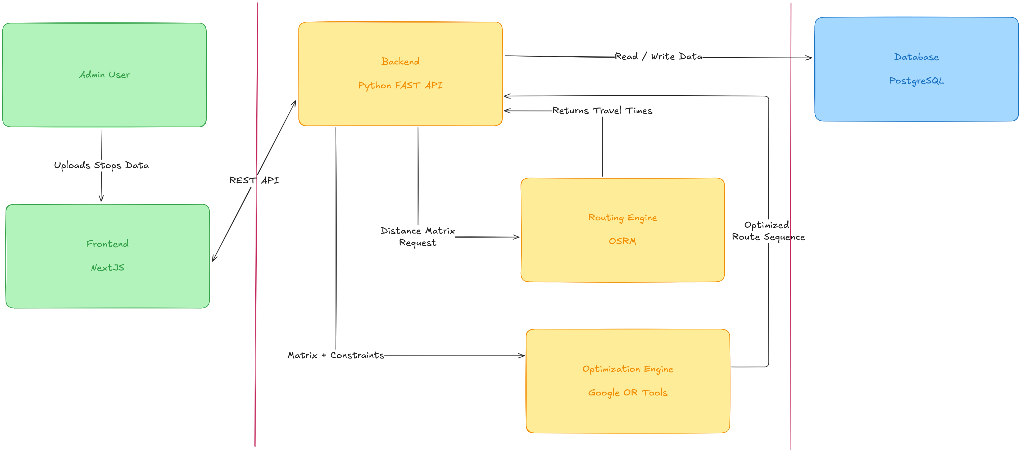
Prototype/Project Flow diagram/Architecture
Notes:
New Courses replaced with New Programmes

Slide 10
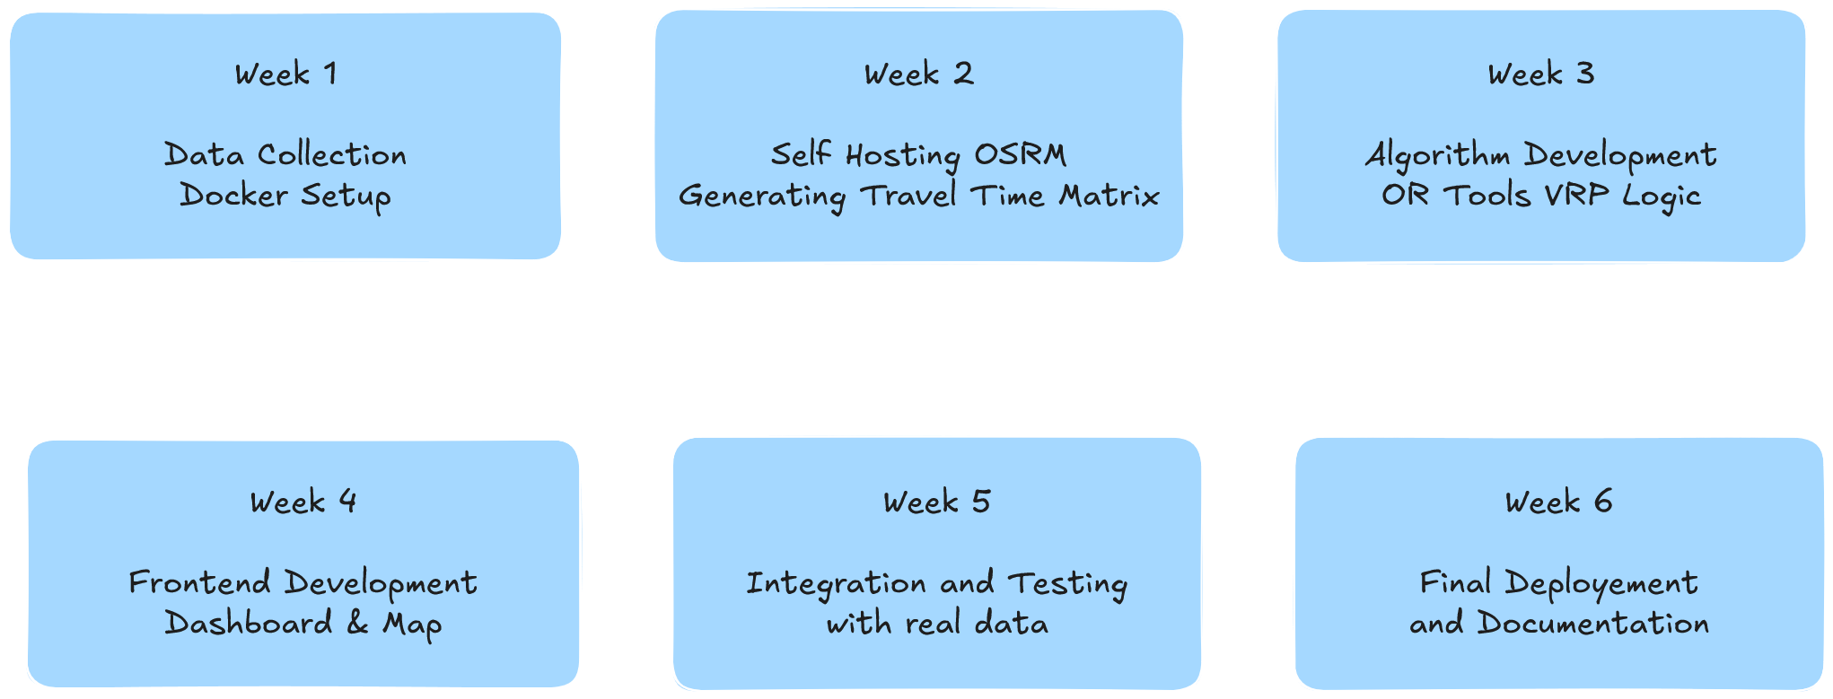
Project Timeline
Notes:
New Courses replaced with New Programmes

Slide 11
Next Steps and Goals
Immediate
- Finalize depot locations to enable the optimization engine
- Run first end-to-end optimization with real data
- Complete route visualization on maps (color-coded polylines)
Upcoming
- Scenario comparison (Strict vs Suggested plans)
- CSV/PDF export for driver route sheets
- Mobile-friendly driver view
Final Phase
- Full Docker deployment (one-command setup)
- Documentation & testing
Notes:
New Courses replaced with New Programmes

Slide 12
Data & Resources
Data Sources
Map Data: OpenStreetMap (OSM) extracts for North India (via Geofabrik).
Stop Data: Geotagged coordinates for student pickup points across Palwal, Faridabad, Noida, etc.
Software & Frameworks
Frontend: Next.js (React), Leaflet.js, TanStack Query.
Backend: Python, FastAPI, Pandas.
Optimization: Google OR-Tools, OSRM (Open Source Routing Machine).
Hardware
Standard University Server or Laptop (No GPU required).
Docker environment for containerization.
Notes:
New Courses replaced with New Programmes

Slide 13
Project Use cases & Scope
Primary Use cases:
Semester Planning:
Generating the master route schedule at the start of every academic session.
Budget Optimization:
Estimating and reducing fuel budgets by optimizing route kilometers.
Feasibility Testing:
Checking if new routes to distant towns (e.g., Rewari) are viable within time limits.
Scope:
Geographic:
Covers the entire K.R. Mangalam University catchment area (Sohna, Gurugram, Faridabad, Noida, Palwal, Bhiwadi).
Operational:
Focuses on static planning and fleet scheduling (Does not include real-time GPS tracking hardware).
Notes:
New Courses replaced with New Programmes

Slide 14
Expected Results & Impact
Operational Savings:
100% elimination of software licensing costs.
Estimated 10-15% reduction in fuel consumption due to optimized paths.
Efficiency:
Reduction in manual planning time from weeks to minutes.
Balanced passenger loads, preventing overcrowding on popular routes.
Sustainability:
Reduction in carbon footprint by minimizing deadhead (empty) kilometers.
Notes:
New Courses replaced with New Programmes

Slide 15
THANK YOU

